Slide 1
Distribution of 3D standard contents June 8 2011
Jun Okamoto (NTT)

Slide 2
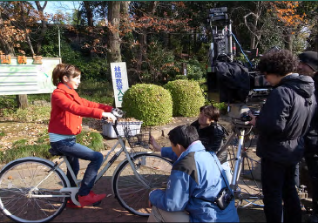
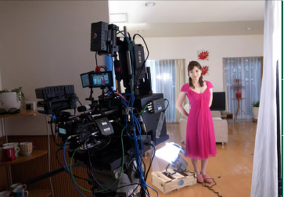
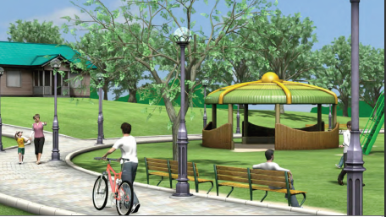
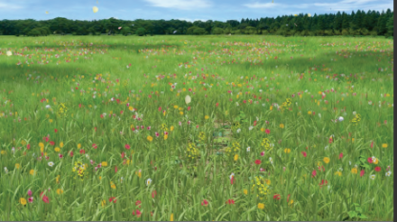
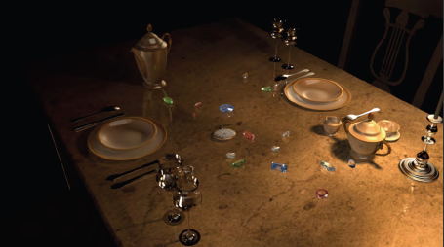
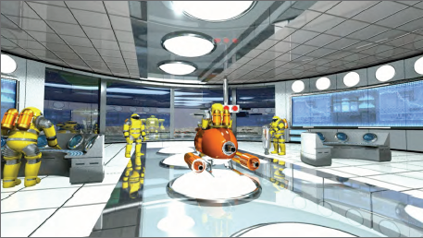
1. Contents overview (1/2)
Ultra-high resolution stereo 3D contents [4.0TB] (Indoor:1.8TB, Outdoor:1.5TB, Digest:756GB)
Ultra high quality 3D contents made using ultra-high resolution stereo camera (4K3D)
2) 3D CG contents [65GB)]
High resolution CG model scenes and CG movies (6 scenes)
Outdoor
Indoor

Slide 3
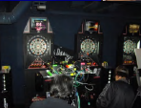
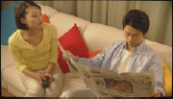
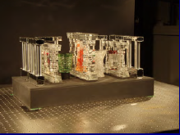
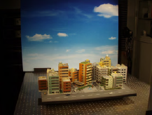
1. Contents overview (2/2)
3) 3D contents made using range cameras [370GB]
Flexibly convertible depth image contents
4) 3D contents made using scanning cameras [103GB]
Contents made using a dense array of cameras with full parallax
Captured using 3 cameras (left, right, renge),
And created the depth images
Living
Office
Dance
Darts
There consist of the following :
- Horizontal 150 view point,
- Vertical 100 view point
Crystal
Diorama
There are the detail information at http://3d-contents.nict.go.jp/ (only Japanese)

Slide 4
2. Conditions for distribution(1/4)
Scope of usage:
1) Assessment and management for research in and development of related devices.
2) Industry standardization analysis and educational quality evaluation.
3) Assessment and management during production, editing, and screening.
4) Display at trade fairs and exhibitions.
Prohibitions:
1) Redistribution and copying for users not included in the license agreement.
2) Display, broadcast, and distribution for commercial purposes.
3) Re-editing (altering and plagiarising).

Slide 5
2. Conditions for distribution(2/4)
Submission of report of use：
1) For video screening at trade fairs and exhibitions, a report of usage must be submitted every six months.
2) For presentation at academic meetings of research and development based on these contents or in industry standardization activities, a report of presentation activities must be submitted every six months.
Period of use：
Usage of contents is allowed only until the end of March 2012. If no notice of termination is sent within three months from the date of expiration, the license period will automatically be extended for one year.

Slide 6
2. Conditions for distribution(3/4)
Reminders/precautions:
1) For public screening, the all contents must be shown, from the opening to closing credits.
2) In writing reports for results of research activities, the enclosing frame numbers or time codes of the segments used must be specified, and “3D contents” must be written to indicate the source, in the case that only portions of the content were used.
3) All contents were produced by the National Institute of Information and Communications Technology (NICT) during FY2009; prior permission from NICT must be obtained for usage and copyright issues not specified in this notice.

Slide 7
2. Conditions for distribution(4/4)
- When the format is changed (e.g. from 4K to HD) or when compression or decompression is done, details of the changes must be indicated during exhibition.
Example: “4K 3D contents from NICT were converted to JPEG2K scalable video codec and displayed in VGA size…”
- The 3D contents are not for redistribution but if you wish to distribute to members of industry standards body and similar organizations, please request permission for it.
- Please contact NICT for inquiries about cases not covered in the scope and prohibitions indicated here.
- NICT does not offer support for conversion of distributed contents.

Slide 8
3. Procedure for distribution
- If you want to access NICT 3D contents, please send me (okamoto.jun@lab.ntt.co.jp) the following information.
1) The name of organization
2) Requested contents
3) Contact information (person, email, phone, address)
You do not need to contract for NDA with NTT; however, you need to comply with Sec. 2 (Conditions for distribution)
- Copying process
If it is difficult to copy for all organization because of the large amount of data. After that organization receives and copies it, it will send the HDD to the next organization.
Beforehand, please prepare 6-TB USB3.0 HDD in order to copy quickly.

